Slide 1
Number systems
The numbers can be represented in various formats: binary, decimal, hexadecimal, octal, BCD & ASCII.
A number N in any number system can be expressed as
N= S _{n} * B ^{n} + S _{n-1} * B ^{n-1} + S _{n-2} * B ^{n-2} +…….+ S ₁ * B ¹ + S ₀ * B ⁰
Where S is symbols used in that number system . B is the base of that that number system.
Eg1 Decimal has 10 symbols (= 0,1,2,….9)
The number 1234 in decimal can be expressed as
1234 = 1 * 10 ³ + 2 * 10 ² + 3 * 10 ¹ + 4* 10 ⁰

Slide 2
Eg2 Hexadecimal has 16 symbols (= 0,1,2,….9, A,B,C,D,E,F)
Hex number 3A9F can be expressed as
3A9F = 3 * 16 ³ + A * 16² + 9 * 16¹ + F * 16 ⁰
Eg3 Binary has 2 symbols ( 0,1)
The number 1011 can be represented as
1011 = 1 * 2 ³ + 0 * 2 ² + 1 * 2 ¹ + 1 * 2 ⁰
Computer can work only on binary format. But which is difficult for user to work with. So, for user’s convenience, the binary number is represented in other forms by using suitable programs.

Slide 3
Three systems for representing both positive and negative binary numbers:
Sign magnitude representation
1’s complement representation
2’s complement representation

Slide 4
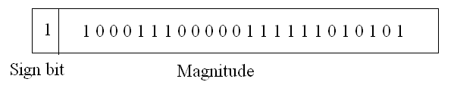
1. Sign-Magnitude representation
Left most bit (MSB) indicates sign
0 means positive, 1 means negative
eg: +18 = 00010010
-18 = 10010010
Problems with Sign-Magnitude representation
1) in arithmetic, the sign and magnitude need to be treated separately , difficult to implement by H/W
2) Two representations of zero (+0 and -0)
+ 0 = 0 000 0000
- 0 = 1 000 0000

Slide 5
2. 1’s Complement representation
Negative values are obtained by complementing each bit of the corresponding positive number.
+3 = 00000011
-3 = 11111100
+2 = 00000010
-2 = 11111101
+0 = 00000000
-0 =?
This system also has issue of two representation of zero i.e. +0 =00000000 and -0= 11111111

Slide 6
3. 2’s Complement representation
Negative values are obtained by adding 1 to 1’s complement representation.
+3 = 00000011
+2 = 00000010
+0 = 00000000
-3 = 11111101
-2 = 11111110
-0 = 00000000

Slide 7
Easier way to find 2’s complement
Eg for 10101000
Start from right end. copy bits as they are , as long as a 1 is not encountered.
So it is ……….1000
After that complement remaining bits
so 01011000

Slide 8
Benefits of 2’s complement number system
Benefit 1:
Only One representation of zero
Zero = 00000000
Bitwise not= 11111111
Add 1 to LSB 1
Result = 1 00000000
Overflow is ignored, so:
- 0 = +0 √
Benefit 2 : Arithmetic operations can be done easily

Slide 9
Range of Numbers
For n bit number , the total numbers are 2 ^{n}
n bit 2’s complement
(+)ve no. range = 2^{n-1} -1
(-)ve no. range = -2^{n-1}
8 bit 2’s complement
01111111 = 2⁷ -1 = +127
10000000 = -2⁷ = -128
16 bit 2s complement
011111111 11111111 = 2¹⁵ – 1 = +32767
100000000 00000000 = -2¹⁵ = -32768

Slide 10
Represent following number in to all 3 formats : - 13

Slide 11
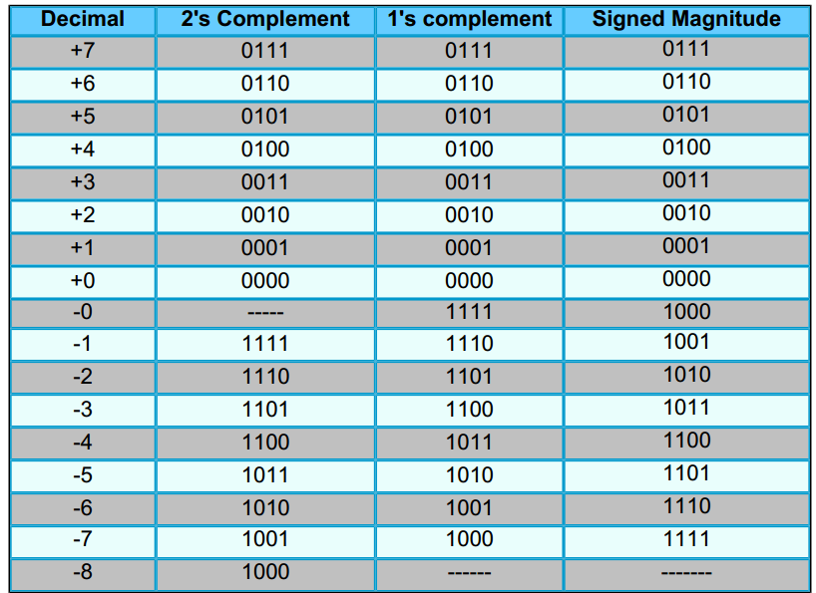

Slide 12
Integer arithmetic
Just like decimal numbers, arithmetic operations such as addition, subtraction, multiplication & division can be performed on binary numbers also.
We will study + - *

Slide 13
Binary addition
We will study
half adder ( single bit),
full adder ( single bit),
ripple carry adder ( multiple bit)
Fast adder using carry look ahead
Half Adder, Full Adder are already covered in DELD Unit II- ( Combinational Logic Design )

Slide 14
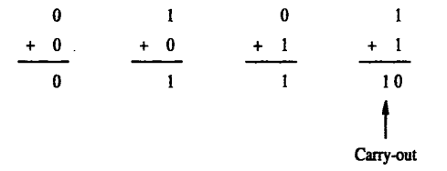
Half adder
Sum S=A⊕B
Carry C=A⋅B
A | B | Sum | Carry | Result
0 | 0 | 0 | 0 | 0
0 | 1 | 1 | 0 | 1
1 | 0 | 1 | 0 | 1
1 | 1 | 0 | 1 | 10

Slide 15
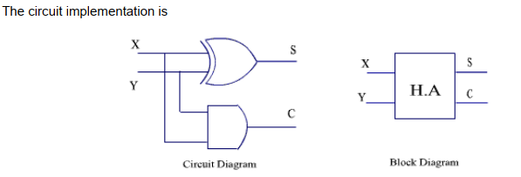

Slide 16
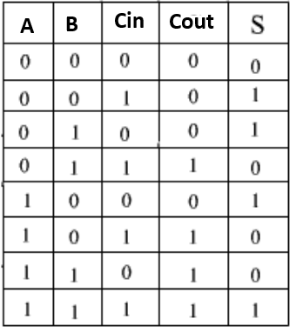


Full adder ( single bit )
Adds total three bits, ( A , B & Cin :the carry from previous bit addition )

Slide 17
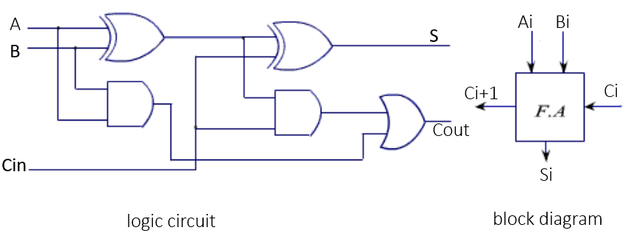
Such n full adder blocks can be used to add two n bit numbers

Slide 18
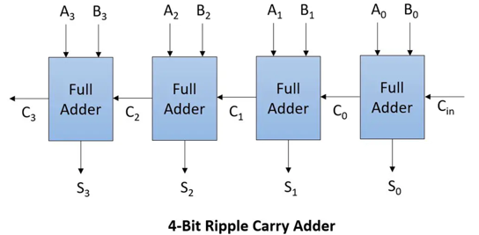
Design 4 bit full adder using single bit full adders
This is also called Ripple Carry Adder ( RCA)
Because carry from previous stage is propagated ( ripple) to next stage

Slide 19
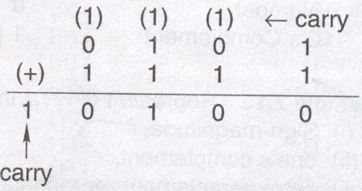
E.g. Add the binary numbers: 101 & 1111.

Slide 20
Problem with Ripple Carry Adder
In RCA, the carry out (Ci-1) of one stage becomes the carry in (Ci) for subsequent stage, creating a sequential dependency.
Delay increases with number of bits: Total delay ∝ n
This makes it slow for large word sizes (16-bit, 32-bit, 64-bit).
This problem is solved by using
Carry Look Ahead Adder (CLA) – Fast Adder

Slide 21
Carry Look Ahead Adder (CLA) – Fast Adder
Concept
Instead of waiting for carry to ripple, CLA calculates carries in advance using Generate (G) and Propagate (P) signals.
Generate and Propagate Signals
For each bit position i:
Generate (Gi)
Gi=Ai⋅Bi ​ (Carry is generated at this bit)
Propagate (Pi)
Pi=Ai⊕Bi ​ (Carry is propagated if present)

Slide 22
Carry Equations (4-bit CLA)
Let input carry be C0.
C1=G0 + P0C0
C2=G1 + P1G0 + P1P0C0
C3=G2 + P2G1 + P2P1G0 + P2P1P0C0
C4=G3 + P3G2 + P3P2G1 + P3P2P1G0 + P3P2P1P0C0
Note: Carries are computed in parallel, not sequentially.
Sum equation:
Si=Pi⊕Ci

Slide 23
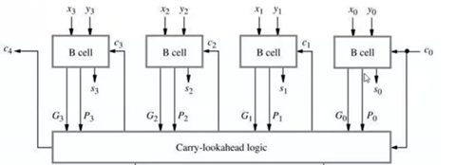
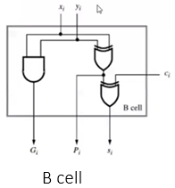
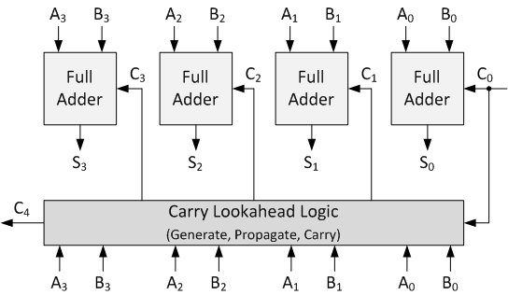
Design 4 bit adder using CLA
Or

Slide 24
Advantages of Fast Adder (CLA)
Very high speed
Delay independent of number of bits (to large extent)
Used in modern processors (ALU)
Disadvantages
More hardware complexity
Increased cost
Not economical for very small bit adders

Slide 25
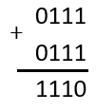
OVERFLOW RULE:
If two numbers are added, and they are both positive or both negative, then overflow occurs if the result has the opposite sign.
Eg add 0111 & 0111
Both numbers are positive ( 7 & 7)
But result is negative , so there is overflow and result can’t be used

Slide 26
Binary subtraction
A | B | Difference | Borrow
0 | 0 | 0 | 0
0 | 1 | 1 | 1
1 | 0 | 1 | 0
1 | 1 | 0 | 0

Slide 27
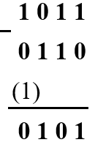
Perform 1011 - 110

Slide 28
Binary subtraction can also be done by using adder ! How?
A - B = A + ( -B)
-b can be obtained by taking B’s complement

Slide 29
Subtraction using complement method
for decimal numbers Using 9’s and 10’s complement
For binary numbers we use 1’s and 2’s complement
Eg . Using 10’s complement for decimal numbers
a-b = a +(- b) = a+ 10’s complement of b ,
then take 10’s complement of result
Eg find 4-8
So 10’s complement of 8 is 10-8 =2
4+2 = 6
Now 10s complement of 6 is 4 , and since 10-8 was +ve , put –ve sign for final result . So final result = -4
So we only need addition and complement circuits

Slide 30
Addition and Subtraction using 2’s complement
Take twos complement of subtrahend and add to minuend
i.e. a - b = a + (-b)
= a + (2’s complement of ‘b’)
So we only need addition and complement circuits

Slide 31






Perform using 2s complement
a) 2+3 b) 4-6 c) -5-2 d) 7-3

Slide 32





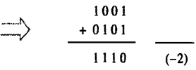

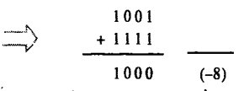

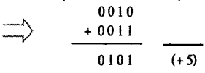
Perform using 2s complement
e)-3-7 g) 6-3 h) -7-5 i) -7+1 j) 2-3

Slide 33
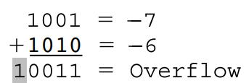
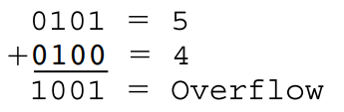
Perform -7 -6 & 5+4

Slide 34
Sign extension
Decimal number 5 can be written as 0101 in 4 bit binary
To store bigger numbers we can use 8 bits
So 5 can be represented as 0000 0101 in 8 bit binary
What about negative numbers?
-5 = 1010 ( in 2s complement form) in 4 bit binary
How to -5 represent in 8 bit size? Which is correct in following ?
a) 0000 1010
b) 1111 1010
Option a is incorrect Because it will change the sign of 8 bit data to 0 (positive)
Option b is correct
Take 2s complement of 1111 1010 & find decimal . It will be -5

